Slide 1
Sorting algorithms & Big O

Slide 2
Sorting data is its own entire subsection within the study of computer science, and there are many well-defined algorithms for sorting.
A sorting algorithm is a function that’s used to efficiently move from having data in a unsorted format into a sorted format that is meaningful to the user.
Examples of the most common sorting algorithms include : Quick Sort, Bubble Sort, Selection Sort, Merge Sort, Heap Sort and others.
The point to note is that ,Each of them has a different approach to get to the same or similar results (sorting)
But if they (almost) all return the same result? Then which one should I use ?
To determine which one should be used, the efficiency of each has to be measured.

Slide 3
How efficient an algorithm is what will determine whether it should be used based on the size of the data(input size).
Thus came asymptotic analysis.
Asymptotic analysis is a method used in computer science and mathematics to analyze the behavior of algorithms as the input size changes.
It provides a way to estimate the performance or efficiency of an algorithm or the growth rate of a function.
Asymptotic analysis is commonly used to classify algorithms into different categories based on their performance characteristics.
The most commonly used notation for asymptotic analysis is the "Big O" notation, The are other notations such as Omega notation and Theta notation

Slide 4
The efficiency of an algorithm depends on two parameters:
  Time Complexity
  Space Complexity
Time Complexity: is defined as the number of times a particular instruction set is executed rather than the total time taken.
Space Complexity: is defined as the total memory space required by the program for its execution.
Both are calculated as the function of input size(n) meaning: in spite of these parameters the efficiency of an algorithm also depends upon the nature and size of the input.

Slide 5
The Big O Notation
Big O notation is a mathematical notation used in computer science to describe the asymptotic upper bound or worst-case time complexity of an algorithm or the growth rate of a function.
As a programmer it is important to know how well your sorting algorithm can perform under the best , average and worst conditions.
Hence both the Time Complexity and the Space Complexity will be measured according to 3 metrics :
Best Case , Average Case and Worst Case.

Slide 6
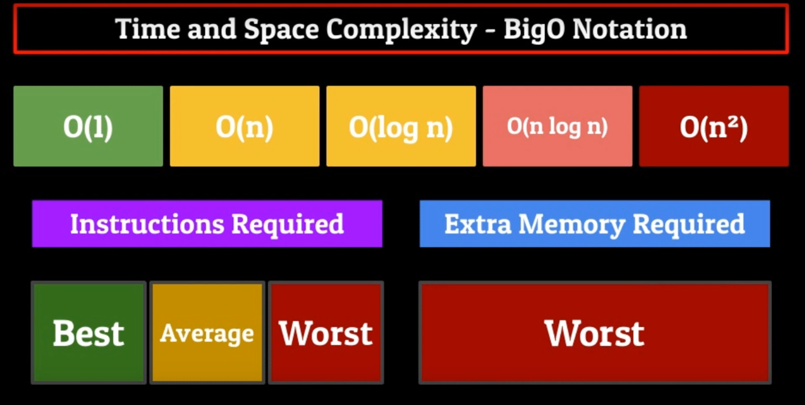

Slide 7
Time and Space Complexity - O(1)
The absolute best that a sorting algorithm can score is a space complexity equation of O(1)
A sorting algorithm can never have a O(1) Time Complexity. Because there is no sorting algorithm that can turn an unsorted list into a sorted list in one single step.
A sorting algorithm having a space complexity of O(1) means that the algorithm does not require additional memory to sort the list .

Slide 8
Time and Space Complexity – O(log n)
The next best type of Big O equation is O(log n).
This equation also cannot be applied to the time complexity equations.
But when it comes to space complexity the algorithm used will require additional memory equal to O log n where n is the size of the list(data) .
This equation follows a logarithmic curve which means that as the size of your data set increases , the rate of change of the amount of extra memory needed to sort that data decreases
An example of such an algorithm is the Binary Search algorithm

Slide 9
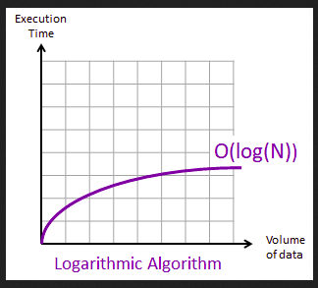

Slide 10
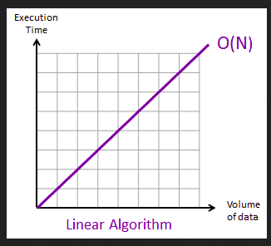
Time and Space Complexity – O(n)
This equations output is Linear meaning: For every element in your data set , the amount of instructions required to sort your data set and the extra memory required to do this sorting, will increase proportionally to the size of the list.

Slide 11
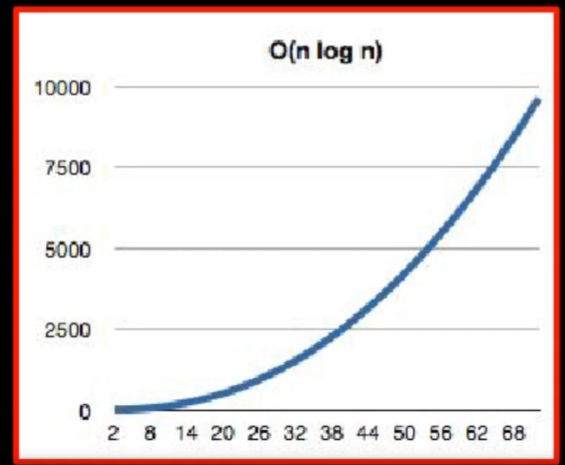
Time and Space Complexity – O(n log n)
O(n log n) is similar to O(log n) the only difference is that it is multiplied by the integer n which is the size of the list of the data to be sorted.

Slide 12
O(n²) is incredibly inefficient when it comes to both time and space complexities.
There are other big O notation equations like O(n log n)² that are algorithm specific equations.

